Slide 1

Ahsanullah University of Science and Technology
Dept. of Computer Science and Engineering
Information System Design and Software Engineering Lab
(CSE 3224)
Hospital Management System
(Interview and Questionnaire)
Submitted By :-
Shadman Sakib (16.01.04.092)
A.K.M. Sadman Ali (16.01.04.093)
Tasmia Tuj Juha (16.01.04.095)
Mehedi Hasan Abir (16.01.04.102)

Slide 2
Sampling Decisions
We have undertaken target oriented method for sampling and it was solely web based.
Google form was used for our targeted research and we used Facebook, Messenger and Whatsapp to get responses.

Slide 3
Sample Design
Sample Size: The sample size was 66.
Parameters of Interest: The subgroup of people having an experience of visiting hospitals and of using internet
Sampling Technique: Probabilistic sampling technique

Slide 4
Data Collection Tools Used
The data collection tools used for the research is ‘Questionnaire’ to get primary data for the research on general people’s preference on online hospital management.

Slide 5
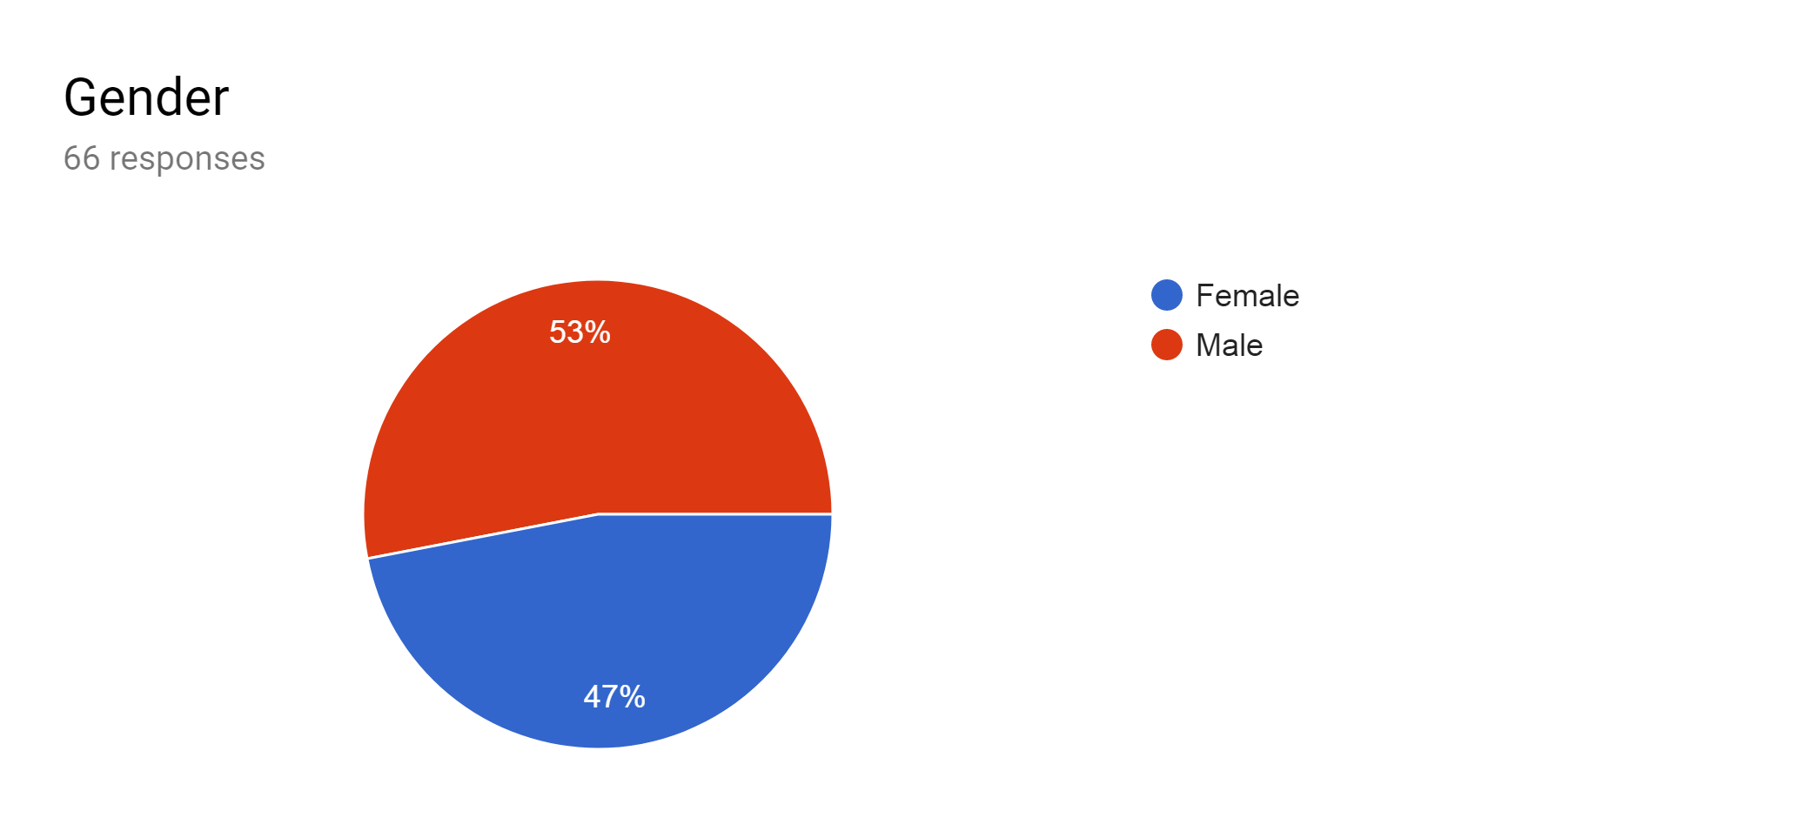
Questionnaire and Data Analysis

Slide 6
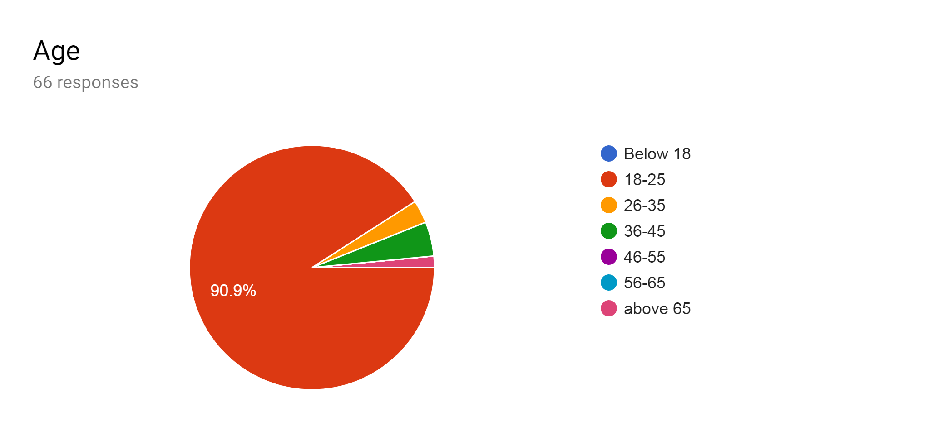
Questionnaire and Data Analysis

Slide 7
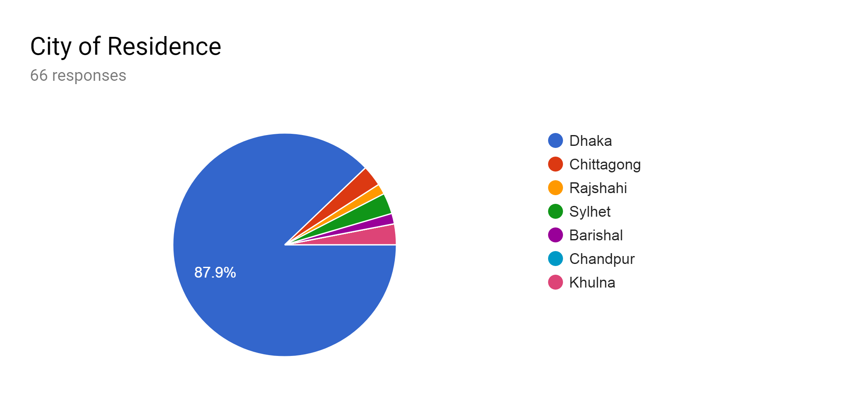
Questionnaire and Data Analysis

Slide 8
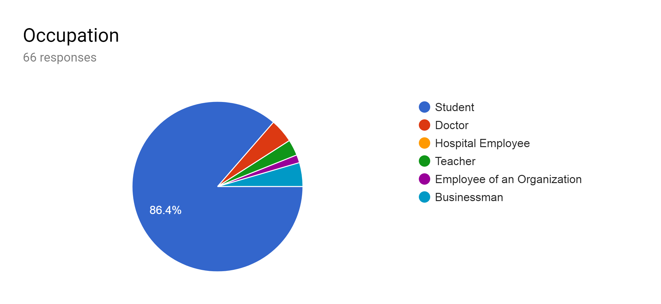
Questionnaire and Data Analysis

Slide 9
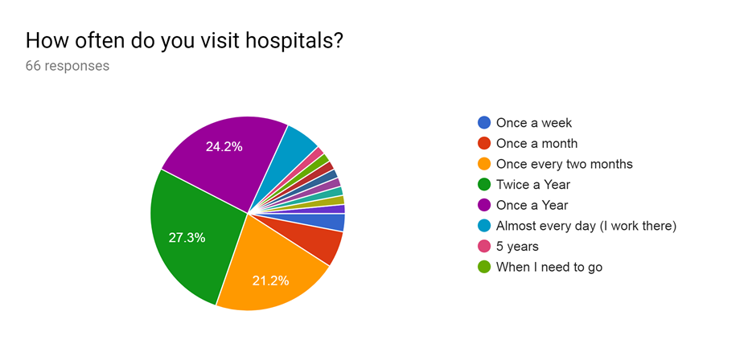
Questionnaire and Data Analysis

Slide 10
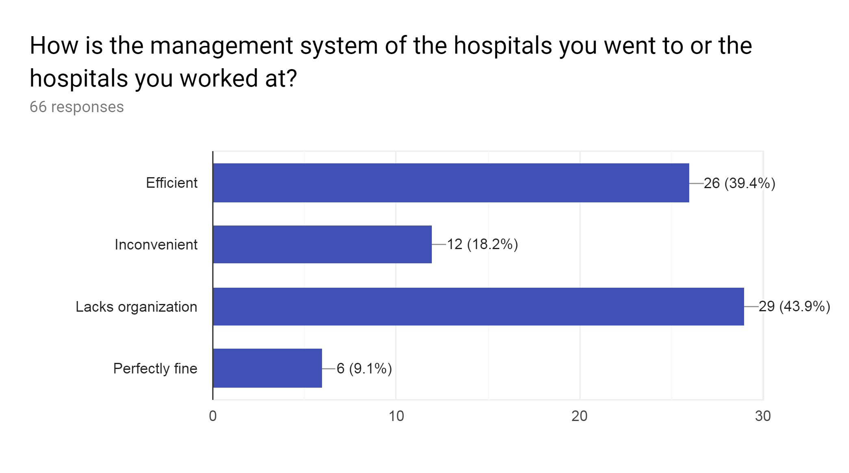
Questionnaire and Data Analysis

Slide 11
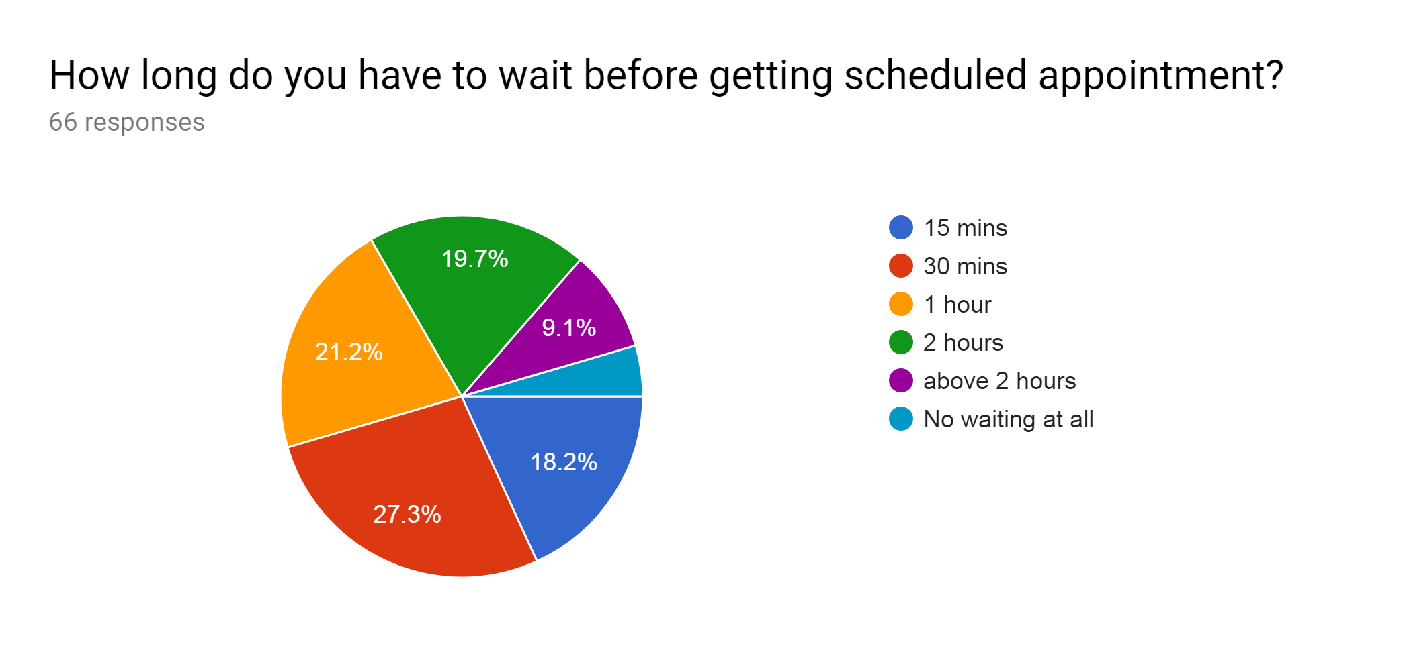
Questionnaire and Data Analysis

Slide 12
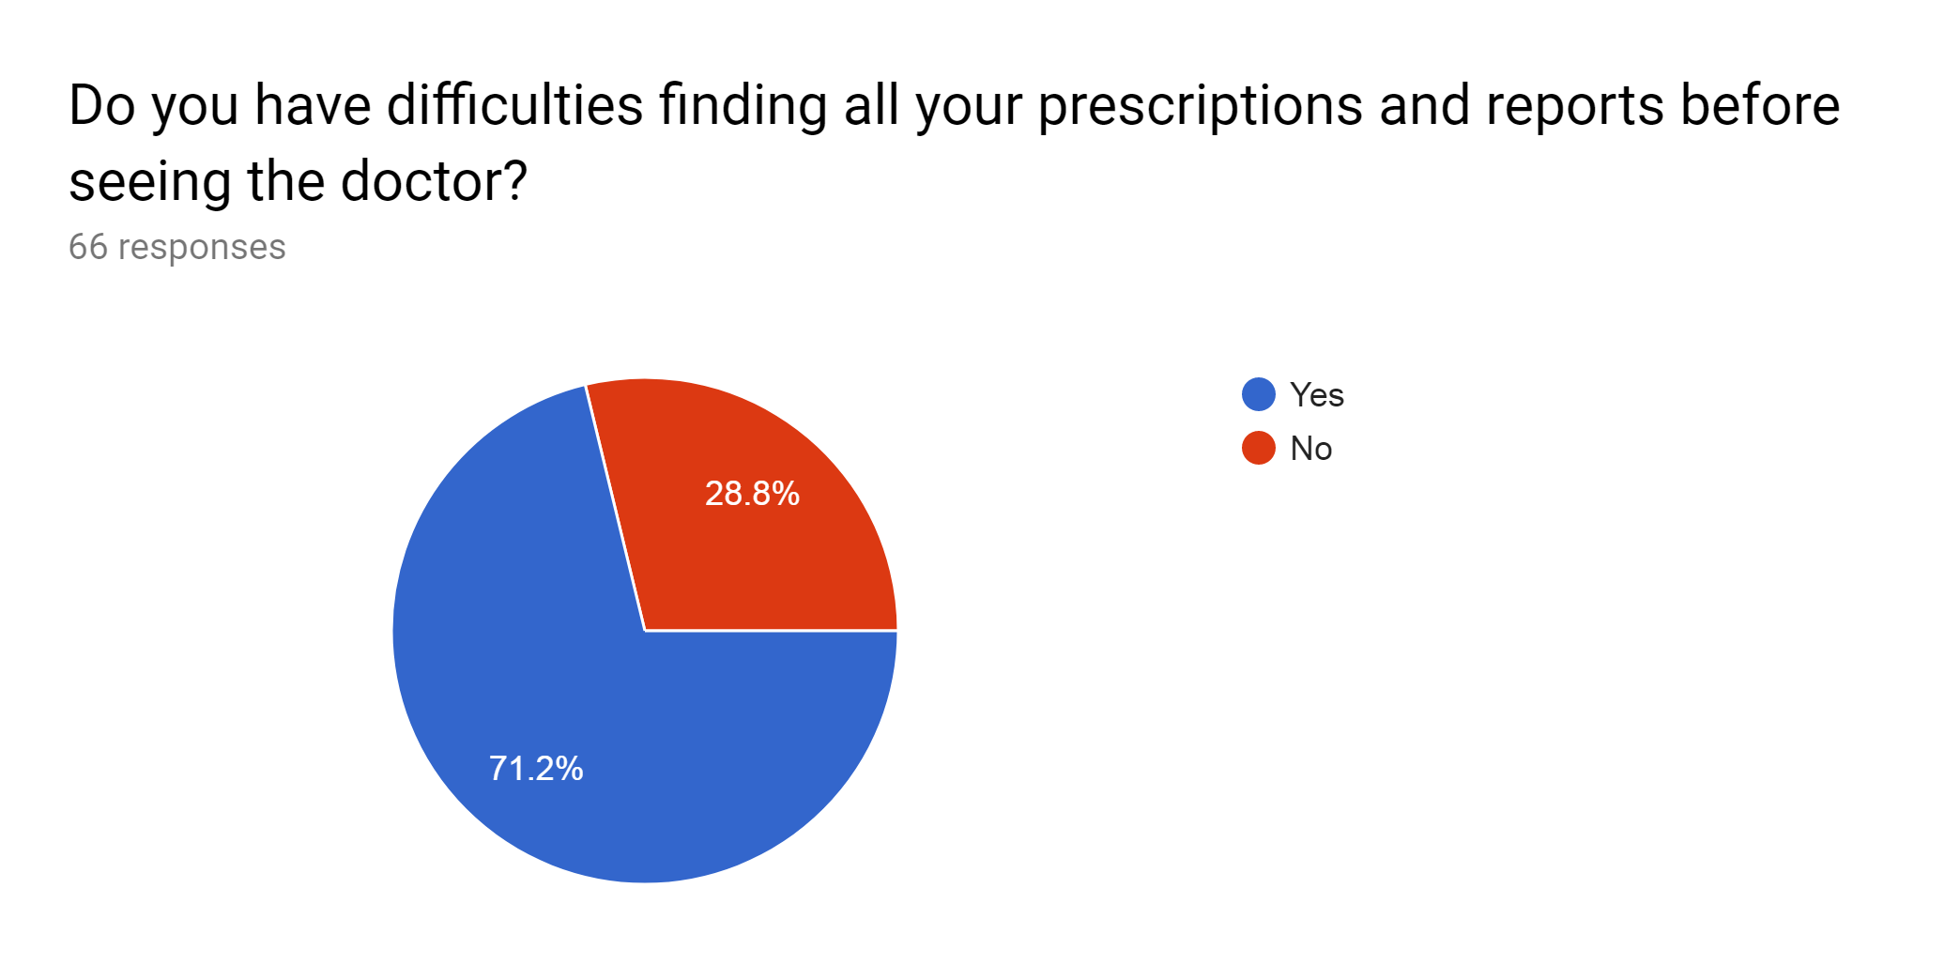
Questionnaire and Data Analysis

Slide 13
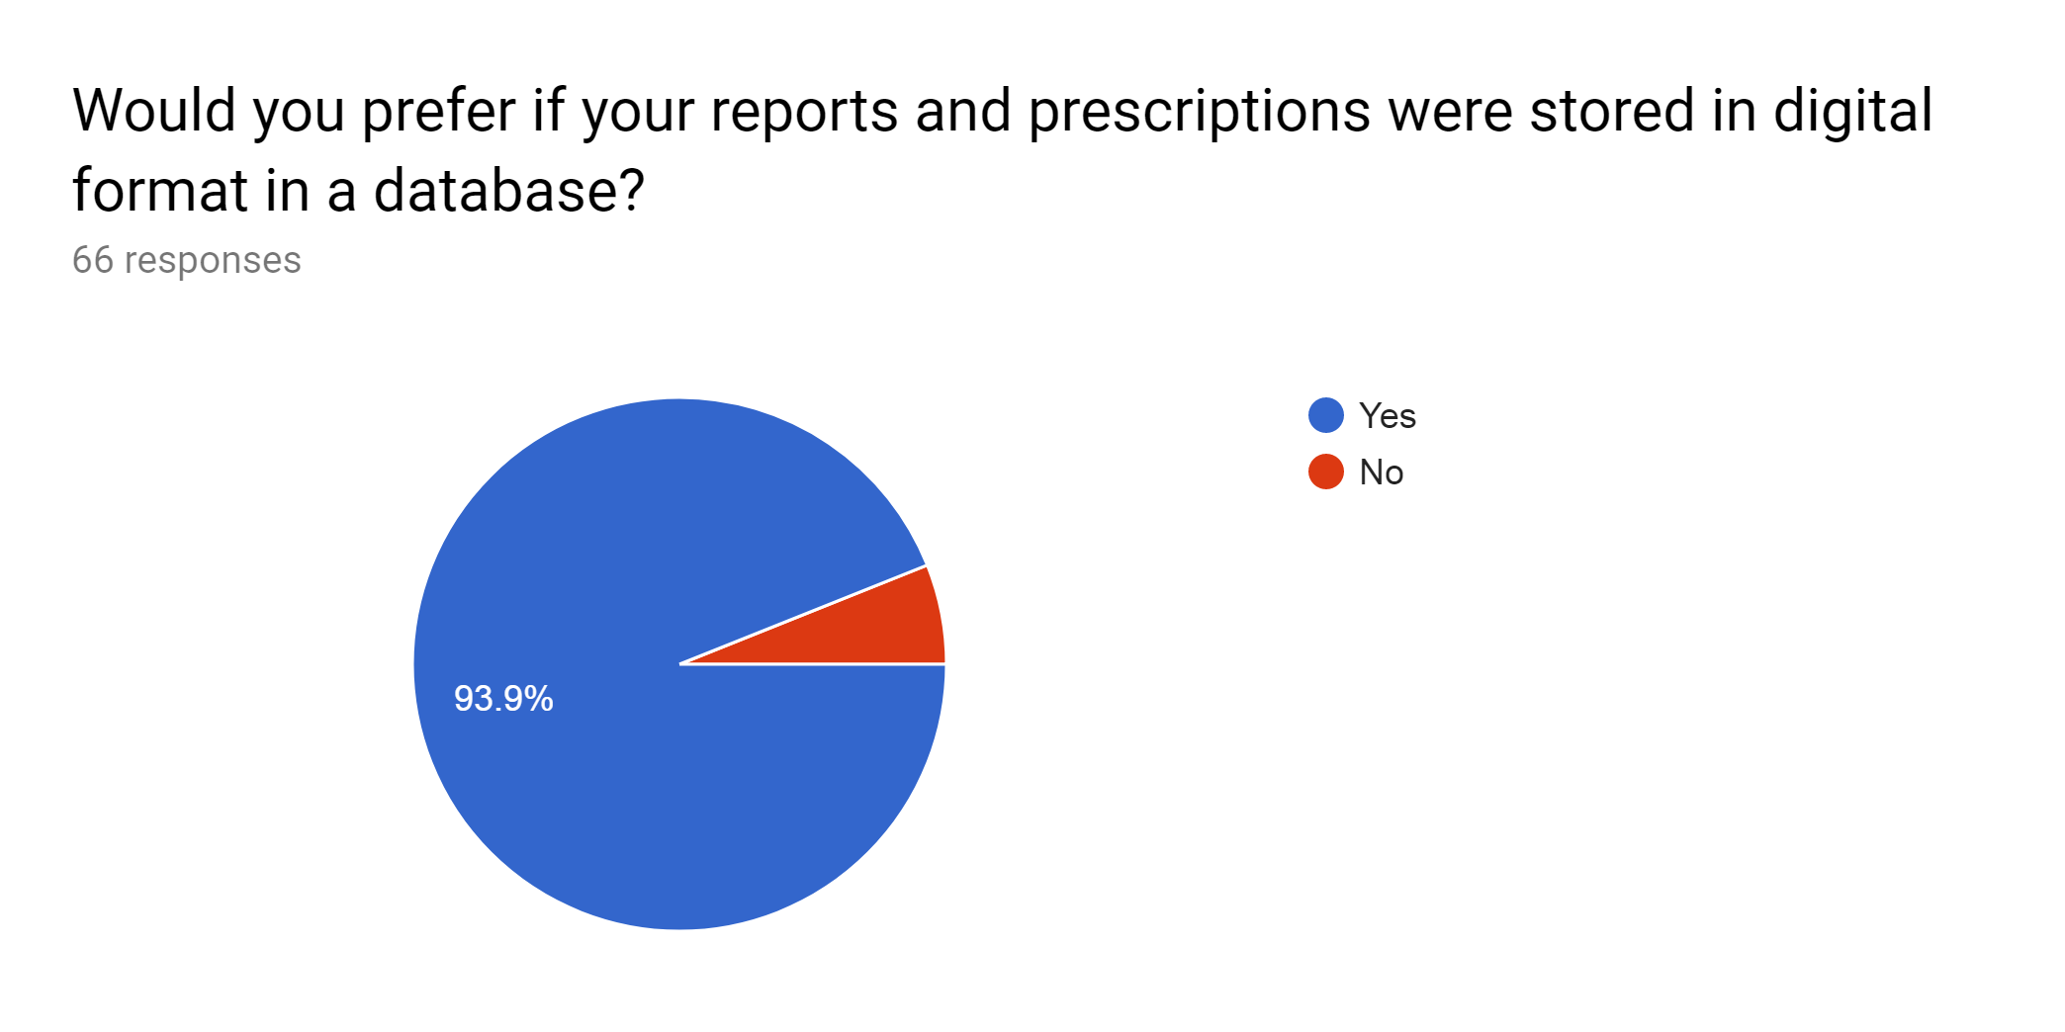
Questionnaire and Data Analysis

Slide 14
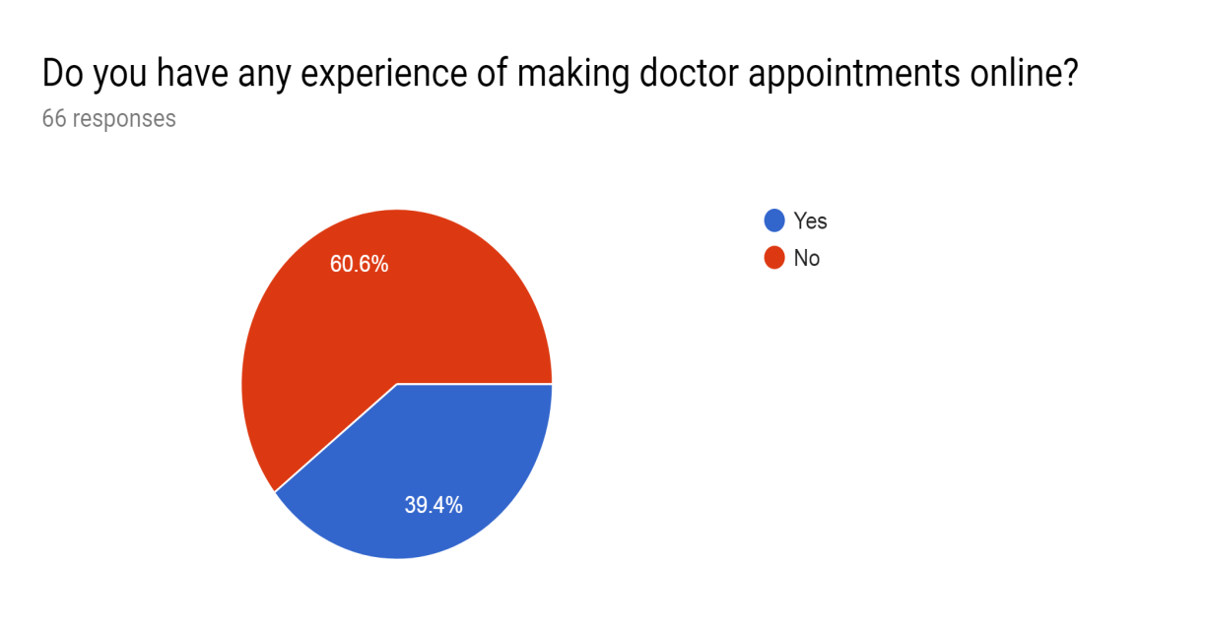
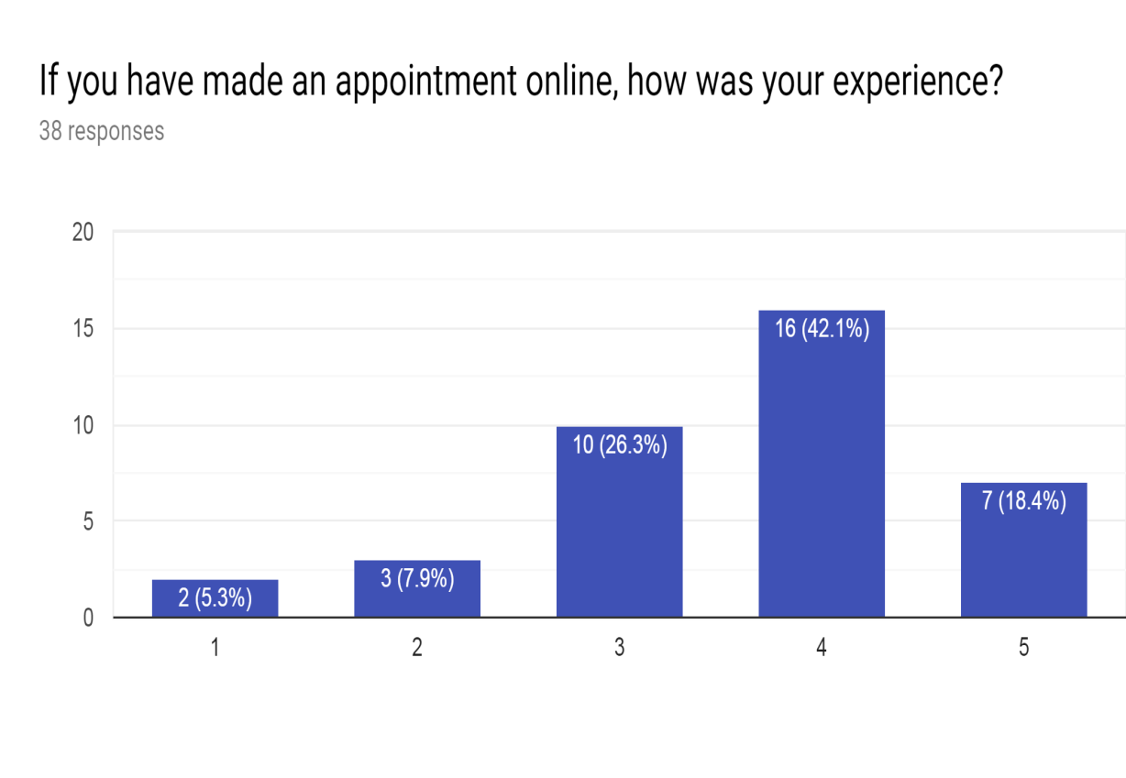
Questionnaire and Data Analysis

Slide 15
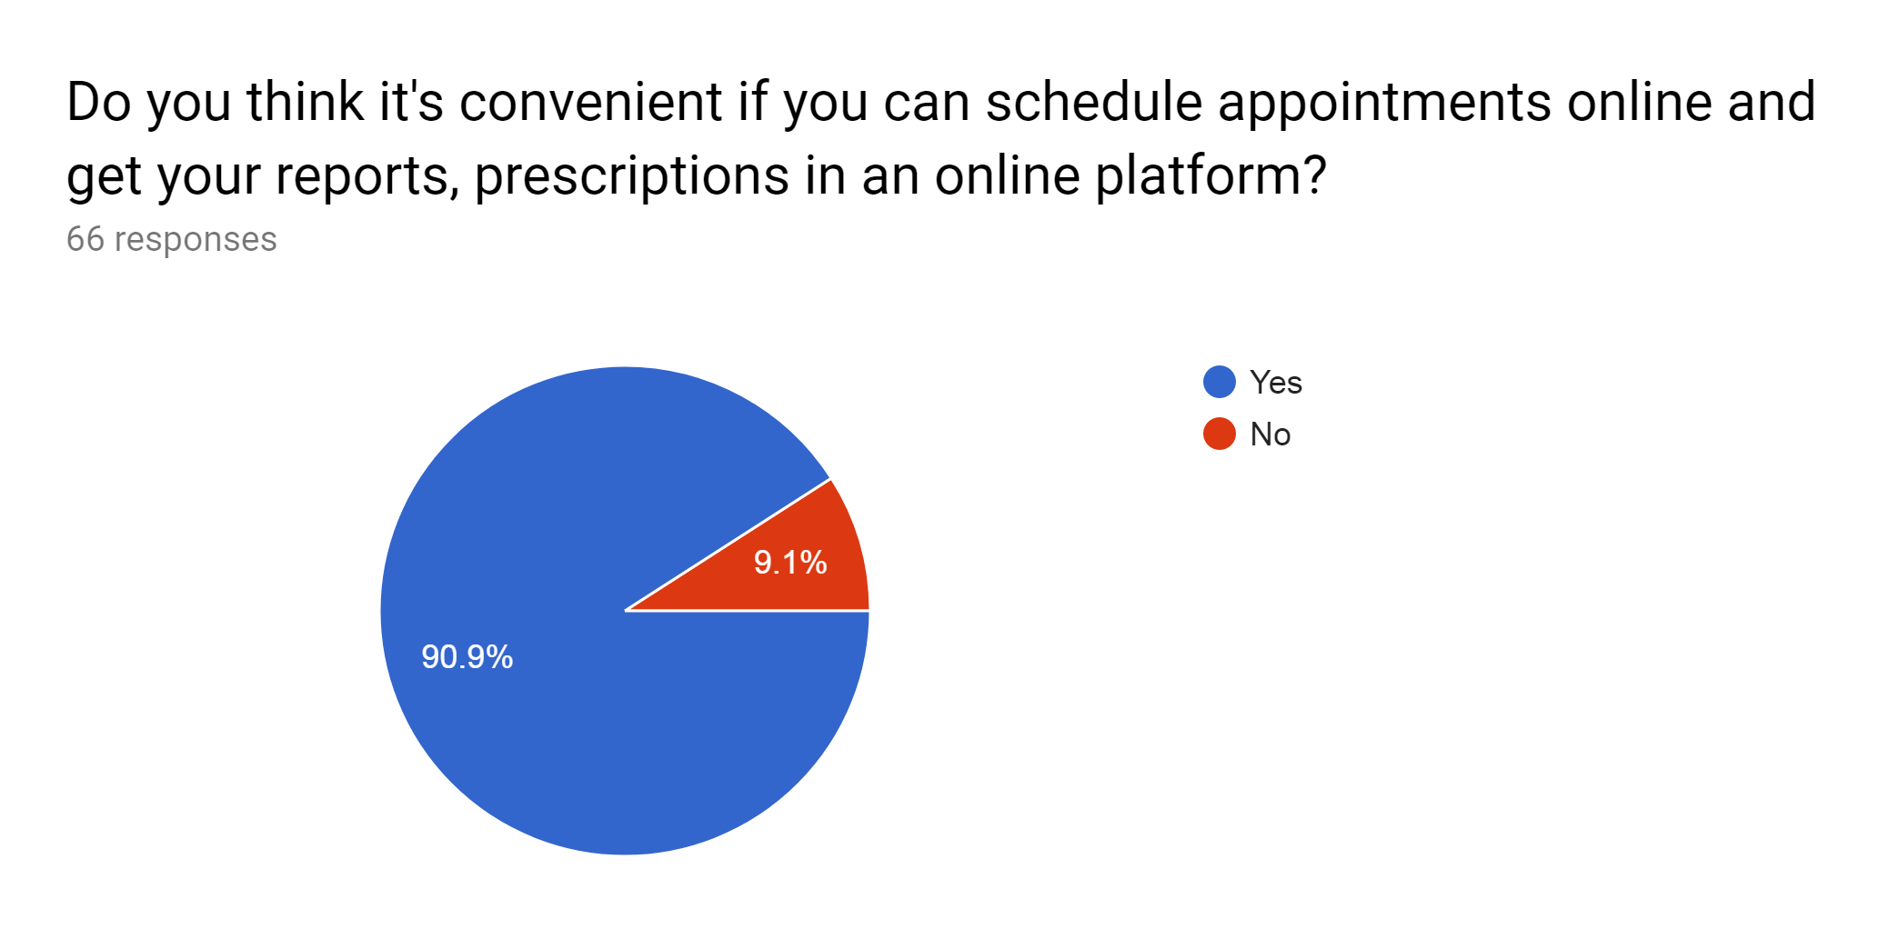
Questionnaire and Data Analysis

Slide 16
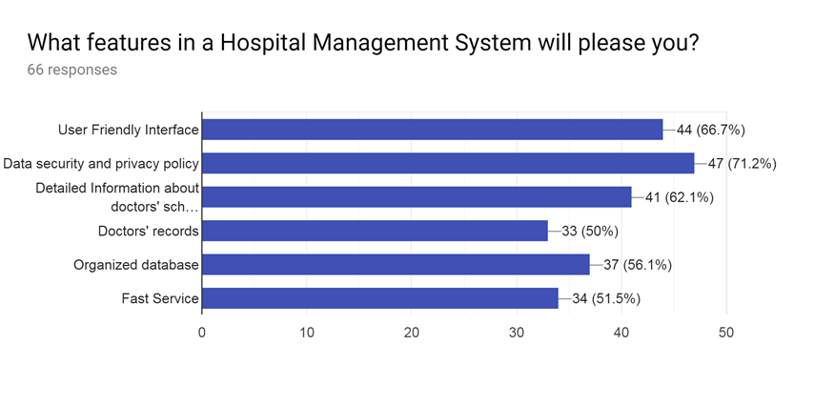
Questionnaire and Data Analysis

Slide 17
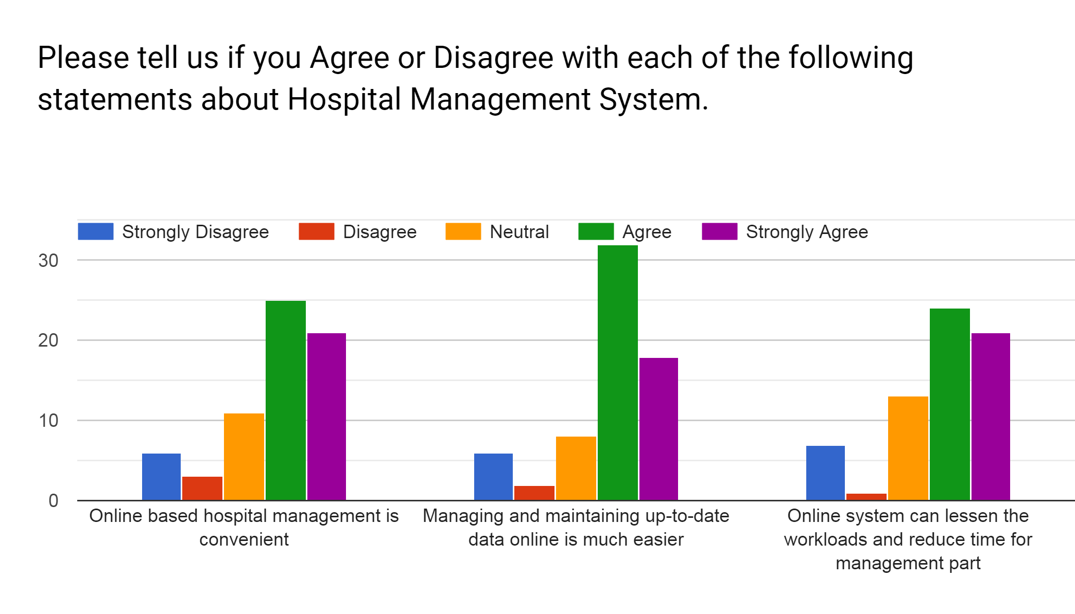
Questionnaire and Data Analysis

Slide 18
Overall Findings
According to the data received from our sample:
Paper-based hospital management systems are neither organized nor convenient.
Patient’s reports and prescriptions are better stored online than in paper.
Online appointment scheduling is preferable for people.
People want friendly interface, data security and doctors information as their top priorities.
In short, people want a fast and efficient management service online that provides security and is easy to use.

Slide 19
Conclusion
Based on this questionnaire, we have received necessary information and insights on how to proceed our project.
Thus, we look forward to making a management system that serves peoples’ needs.

Slide 20
THANK YOU! Any questions?

